Slide 1
CSE 417T Introduction to Machine Learning
Lecture 4 Instructor: Chien-Ju (CJ) Ho

Slide 2
Logistics: Homework 1
Due: September 23 (Friday), 2022
http://chienjuho.com/courses/cse417t/hw1.pdf
Recommend to work on it early to spare time for homework 2
Two submission links: Report and Code
Report: Answer all questions, including the implementation question
Grades are based on the report
Code: Complete and submit hw1.py for Problem 2
The code will only be used for correctness checking (when in doubts) and plagiarism checking
Reserve time if you never used Gradescope.
Make sure to specify the pages for each problem. You won’t get points otherwise

Slide 3
Logistics: Office Hours
Tentative schedule of TA office hours (starting next Monday)
60 minutes per session
Please follow Piazza for additional information
Recommendation: Try to utilize the office hour early (way ahead of deadlines), you are likely to get more of TAs’ time this way
Monday | 11:30am (Herbert Zhou) | 4pm (Dean Yu)
Tuesday | 1pm (Ziqi Xu) | 3:30pm (Neal Huang)
Wednesday | 1pm (Eddie Choi) | 4:30pm (Weiwei Ma)
Thursday | 10am (Jackie Zhong) | 3pm (Fankun Zeng)
Friday | 8am (Shohaib Shaffiey) | 1pm (Yunfan Wang) | 7pm (Hao Qin)
Sunday | 1pm (Jonathan Ma)

Slide 4
Recap

Slide 5
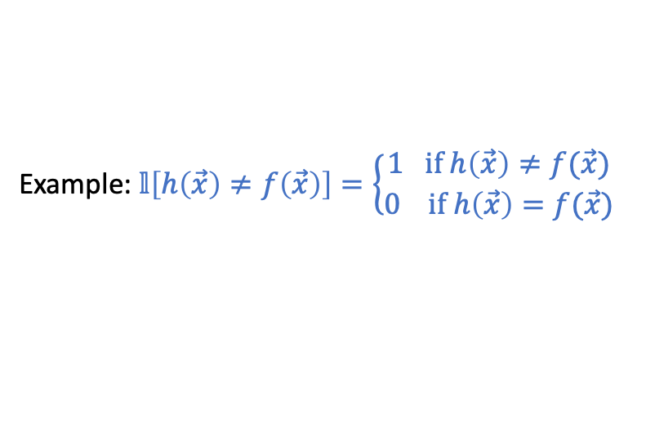
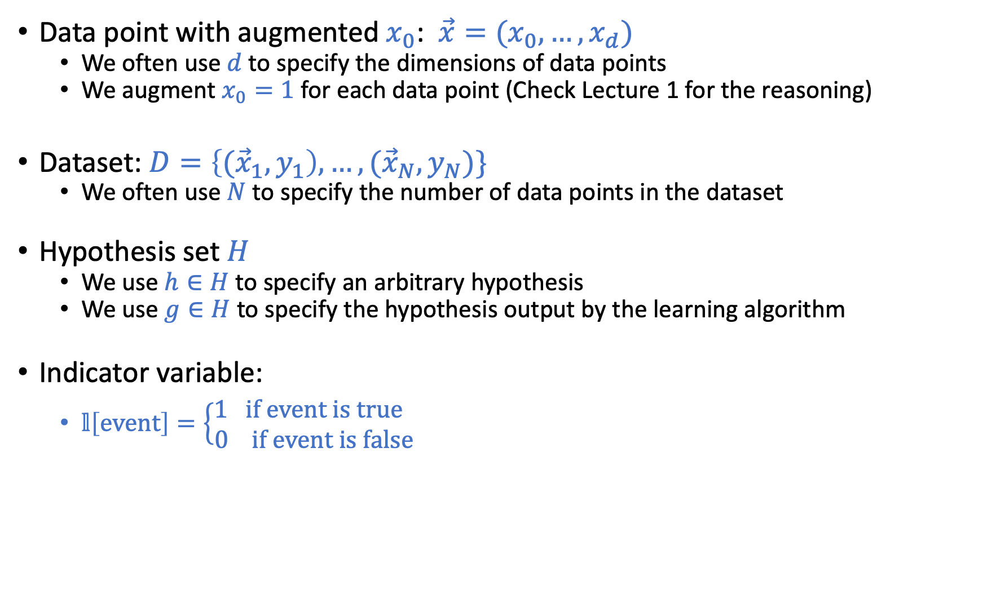
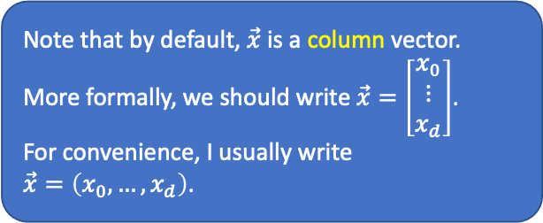
Common Notations
Note that by default, $\vec{x}$ is a column vector. More formally, we should write $\vec{x}=\left[\begin{matrix}x_{0} \\ ⋮ \\ x_{d}\end{matrix}\right]$. For convenience, I usually write $\vec{x}=\left(x_{0},…,x_{d}\right)$.
Data point with augmented $x_{0}$: $\vec{x}=(x_{0},…,x_{d})$
We often use $d$ to specify the dimensions of data points
We augment $x_{0}=1$ for each data point (Check Lecture 1 for the reasoning)
Dataset: $D=\left\{{(\vec{x}}_{1},y_{1}\right),…,({\vec{x}}_{N},y_{N})\}$
We often use $N$ to specify the number of data points in the dataset
Hypothesis set $H$
We use $h∈H$ to specify an arbitrary hypothesis
We use $g∈H$ to specify the hypothesis output by the learning algorithm
Indicator variable:
$𝕝\left[event\right]=\left\{\begin{matrix}1 if event is true \\ 0 if event is false\end{matrix} \right.$
Example: $𝕝\left[h\left(\vec{x}\right)≠f\left(\vec{x}\right)\right]=\left\{\begin{matrix}1 if h\left(\vec{x}\right)≠f(\vec{x}) \\ 0 if h\left(\vec{x}\right)=f(\vec{x})\end{matrix} \right.$

Slide 6
Key assumption in machine learning

Slide 7
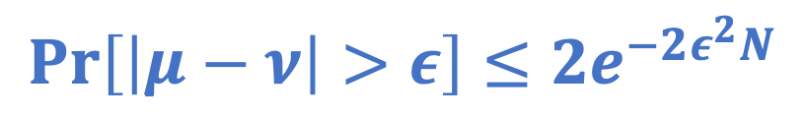

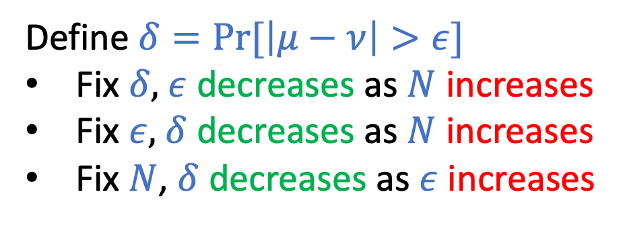
Hoeffding’s Inequality
$$\operatorname{Pr}\left[\left|μ−ν\right|>ε\right]≤2e^{−2ε^{2}N}$$
Draw with replacement
Define $δ=Pr⁡[\left|μ−ν\right|>ε]$
Fix $δ,$ $ε$ decreases as $N$ increases
Fix $ε,$ $δ$ decreases as $N$ increases
Fix $N$, $δ$ decreases as $ε$ increases
N: number of samples
Informal intuitions of notations $N:$ # sample $δ:$ probability of “bad” event
$ε:$ error of estimation

Slide 8
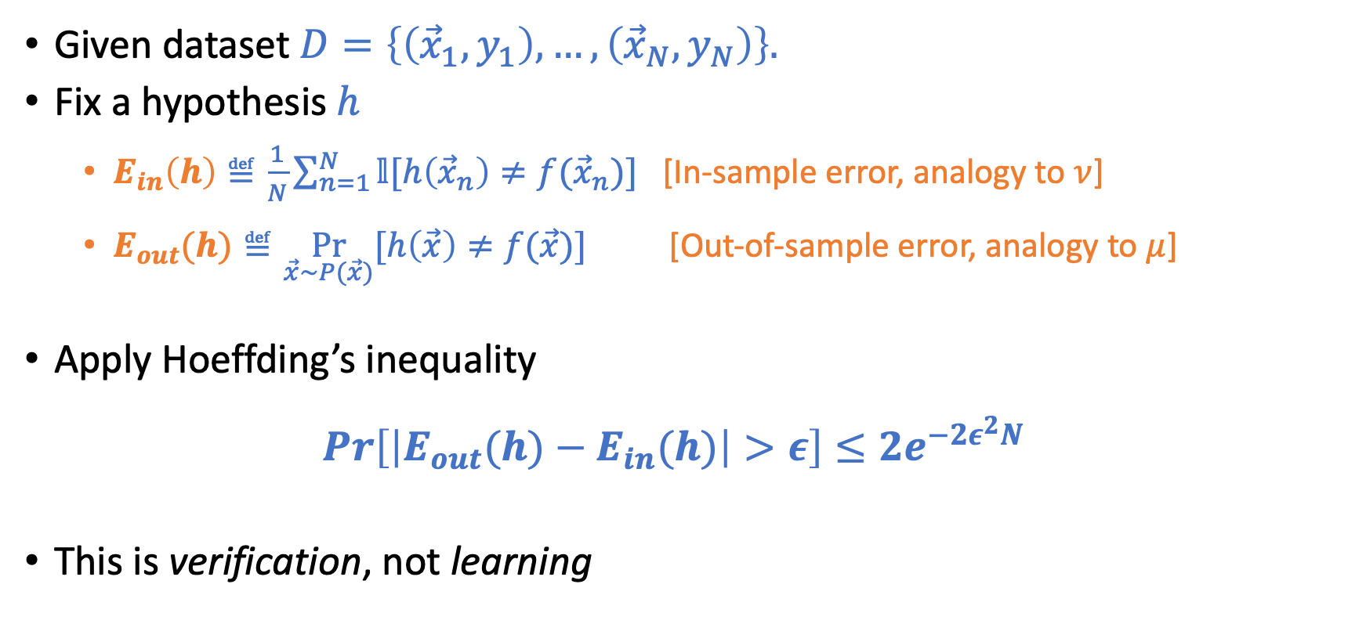
Connection to Learning
Draw with replacement
N: number of samples
Given dataset $D=\left\{\left({\vec{x}}_{1},y_{1}\right),…,\left({\vec{x}}_{N},y_{N}\right)\right\}.$
Fix a hypothesis $h$
$E_{in}\left(h\right)≝\frac{1}{N}\sum_{n=1}^{N}{𝕝[h\left({\vec{x}}_{n}\right)≠f({\vec{x}}_{n})]}$ [In-sample error, analogy to $ν$]
$E_{out}(h)≝\underset{\vec{x}\sim P(\vec{x})}{Pr}{[h\left(\vec{x}\right)≠f(\vec{x})]}$ [Out-of-sample error, analogy to $μ$]
Apply Hoeffding’s inequality $\operatorname{Pr}\left[\left|E_{out}(h)−E_{in}(h)\right|>ε\right]≤2e^{−2ε^{2}N}$
This is verification, not learning

Slide 9
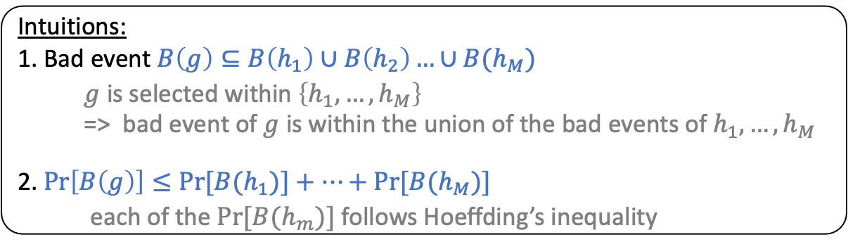
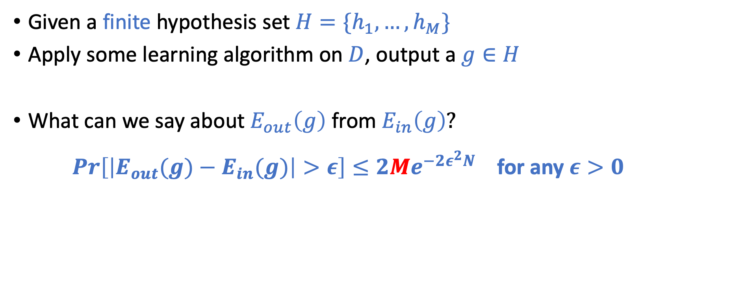
Connection to “Real” Learning
Given a finite hypothesis set $H=\{h_{1},…,h_{M}\}$
Apply some learning algorithm on $D$, output a $g∈H$
What can we say about $E_{out}\left(g\right)$ from $E_{in}\left(g\right)?$
$\operatorname{Pr}\left[\left|E_{out}(g)−E_{in}(g)\right|>ε\right]≤2Me^{−2ε^{2}N}$ for any $ε>0$
Intuitions: 1. Bad event $B\left(g\right)⊆B\left(h_{1}\right)∪B\left(h_{2}\right)…∪B(h_{M})$
$g$ is selected within $\left\{h_{1},…,h_{M}\right\}$
=> bad event of $g$ is within the union of the bad events of $h_{1},…,h_{M}$
2. $\operatorname{Pr}\left[B\left(g\right)\right]≤Pr⁡[B(h_{1})]+…+\operatorname{Pr}{[B(h_{M})]}$
each of the $Pr⁡[B(h_{m})]$ follows Hoeffding’s inequality

Slide 10
Today’s Lecture
The notes are not intended to be comprehensive. They should be accompanied by lectures and/or textbook.
Let me know if you spot errors.

Slide 11
Revisit the learning problem

Slide 12

How to generally characterize $g≈f$

Slide 13
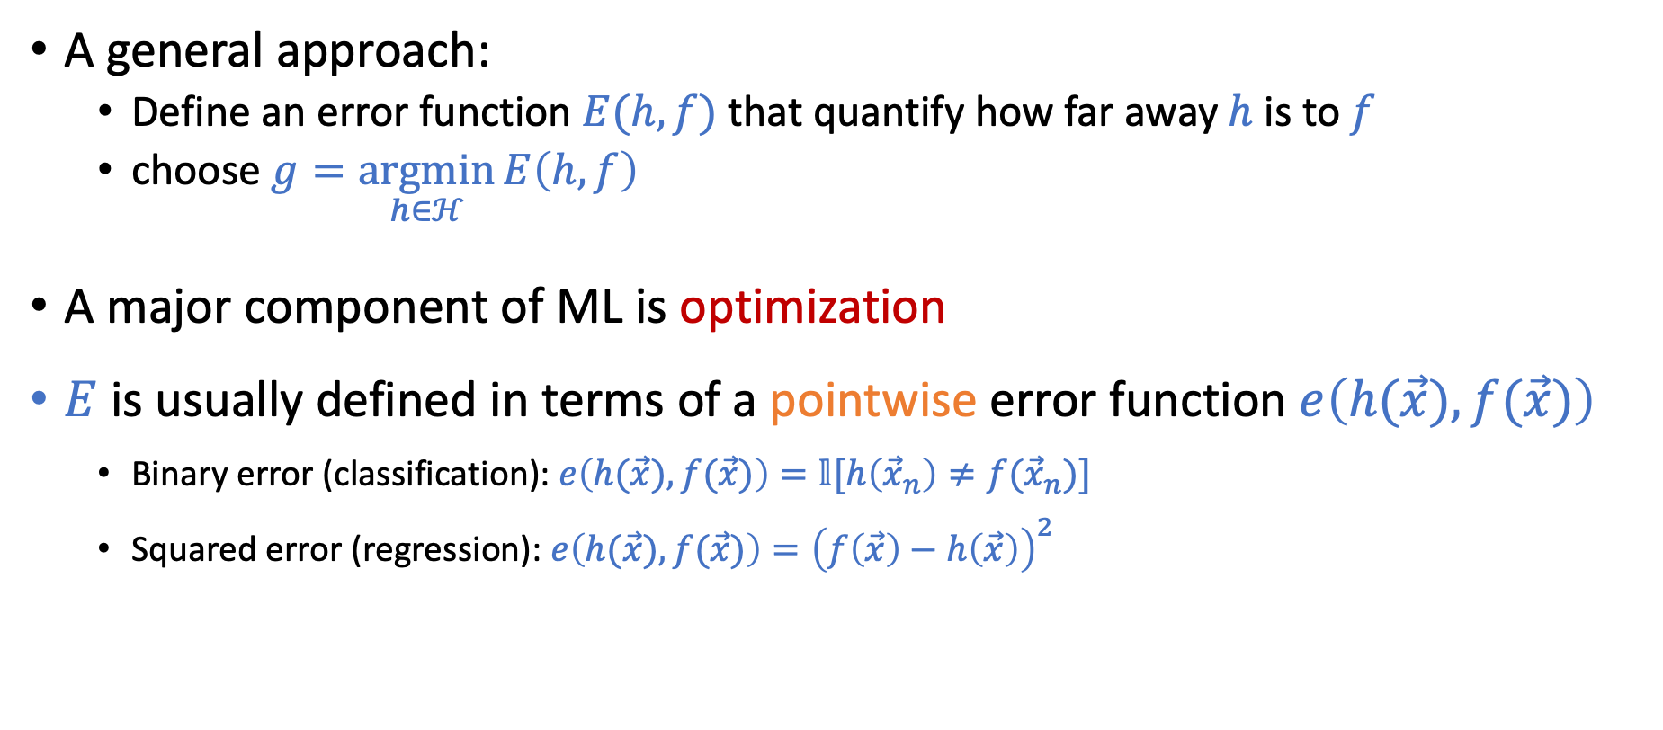


Goal: $g≈f$
A general approach:
Define an error function $E(h,f)$ that quantify how far away $h$ is to $f$
choose $g=\underset{h∈ℋ}{argmin}{E\left(h,f\right)}$
A major component of ML is optimization
$E$ is usually defined in terms of a pointwise error function $e\left(h(\vec{x}),f(\vec{x})\right)$
Binary error (classification):$e\left(h(\vec{x}),f(\vec{x})\right)=𝕝[h\left({\vec{x}}_{n}\right)≠f({\vec{x}}_{n})]$
Squared error (regression): $e\left(h(\vec{x}),f(\vec{x})\right)={\left(f\left(\vec{x}\right)−h\left(\vec{x}\right)\right)}^{2}$
${ E}_{in}\left(h\right)=$ $\frac{1}{N}\sum_{n=1}^{N}{e(h\left({\vec{x}}_{n}\right),f\left({\vec{x}}_{n}\right))}$
$$E_{out}\left(h\right)=𝔼_{\vec{x}}[e(h\left(\vec{x}\right),f\left(\vec{x}\right))]$$
The discussion on the Hoeffding’s inequality applies for general (bounded) error functions.

Slide 14
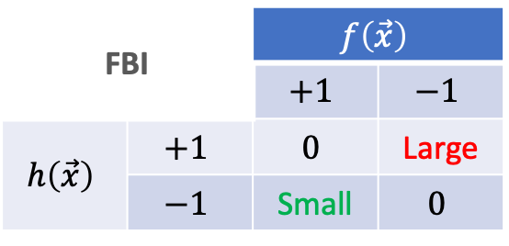
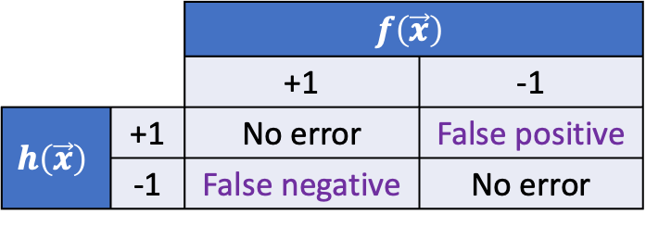
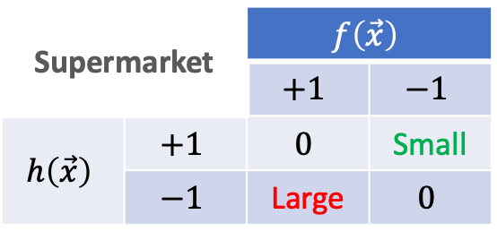
How to choose the error function?
Consideration 1: Properties of domain applications
Example: Fingerprint recognition
Input: fingerprints
Outputs: whether the person is authorized
Supermarket |  | $$f\left(\vec{x}\right)$$
 |  | $$+1$$ | $$−1$$
$$h\left(\vec{x}\right)$$ | $$+1$$ | $$0$$ | Small
 | $$−1$$ | Large | $$0$$
 |  | $$f\left(\vec{x}\right)$$
 |  | +1 | -1
$$h\left(\vec{x}\right)$$ | +1 | No error | False positive
 | -1 | False negative | No error
FBI |  | $$f\left(\vec{x}\right)$$
 |  | $$+1$$ | $$−1$$
$$h\left(\vec{x}\right)$$ | $$+1$$ | $$0$$ | Large
 | $$−1$$ | Small | $$0$$

Slide 15
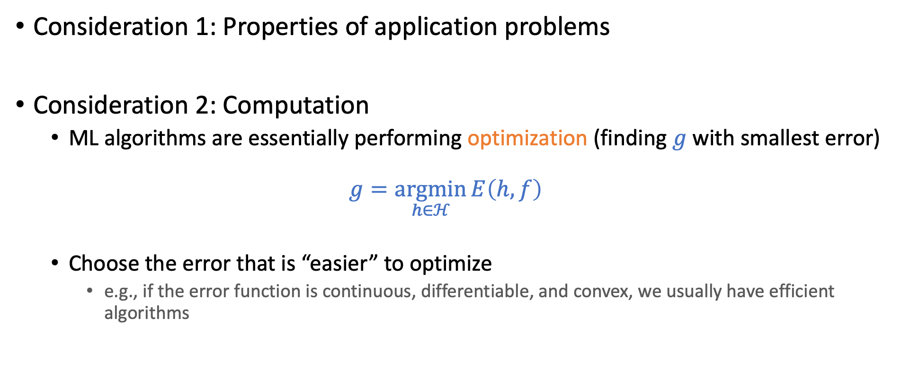
How to choose the error function?
Consideration 1: Properties of application problems
Consideration 2: Computation
ML algorithms are essentially performing optimization (finding $g$ with smallest error)
$$g=\underset{h∈ℋ}{argmin}{E\left(h,f\right)}$$
Choose the error that is “easier” to optimize
e.g., if the error function is continuous, differentiable, and convex, we usually have efficient algorithms

Slide 16
How to choose the error function?
Consideration 1: Properties of application problems
Consideration 2: Computation
Specifying the error function is part of setting up the learning problem
It impacts what you eventually learn

Slide 17

What if $f$ is not deterministic?

Slide 18
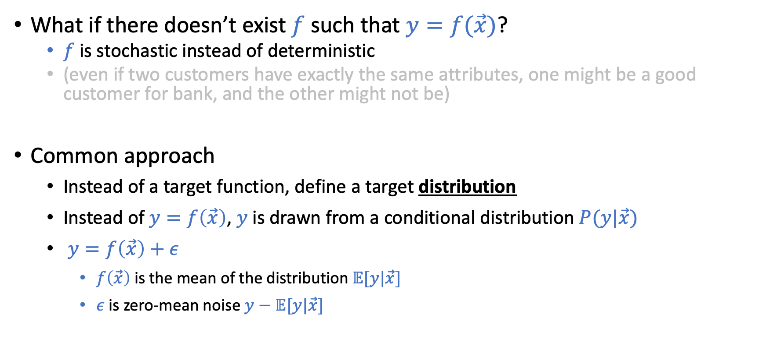
Noisy Target
What if there doesn’t exist $f$ such that $y=f(\vec{x})$?
$f$ is stochastic instead of deterministic
(even if two customers have exactly the same attributes, one might be a good customer for bank, and the other might not be)
Common approach
Instead of a target function, define a target distribution
Instead of $y=f\left(\vec{x}\right)$, $y$ is drawn from a conditional distribution $P(y|\vec{x})$
$y=f\left(\vec{x}\right)+ε$
$f\left(\vec{x}\right)$ is the mean of the distribution $𝔼[y|\vec{x}]$
$ε$ is zero-mean noise $y−$ $𝔼[y|\vec{x}]$
The discussion on the Hoeffding’s inequality applies for noisy targets.

Slide 19
General Setup of (Supervised) Learning

Slide 20
Theory of Generalization

Slide 21
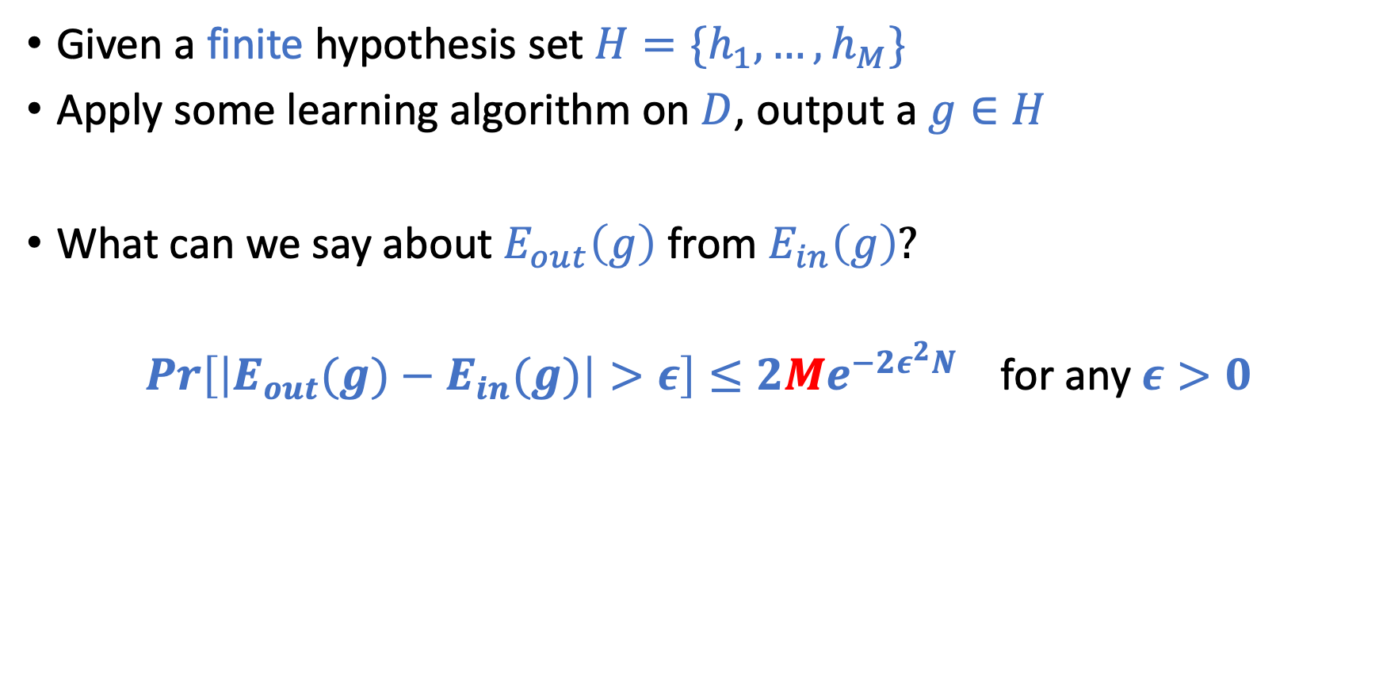
Revisit the “Multi-Hypothesis” Bound
Given a finite hypothesis set $H=\{h_{1},…,h_{M}\}$
Apply some learning algorithm on $D$, output a $g∈H$
What can we say about $E_{out}\left(g\right)$ from $E_{in}\left(g\right)?$
$\operatorname{Pr}\left[\left|E_{out}(g)−E_{in}(g)\right|>ε\right]≤2Me^{−2ε^{2}N}$ for any $ε>0$

Slide 22

What if $M$ is infinite?
$\operatorname{Pr}\left[\left|E_{out}(g)−E_{in}(g)\right|>ε\right]≤2Me^{−2ε^{2}N}$ don’t seem to carry any meanings

Slide 23
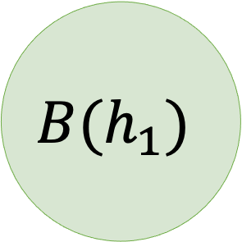
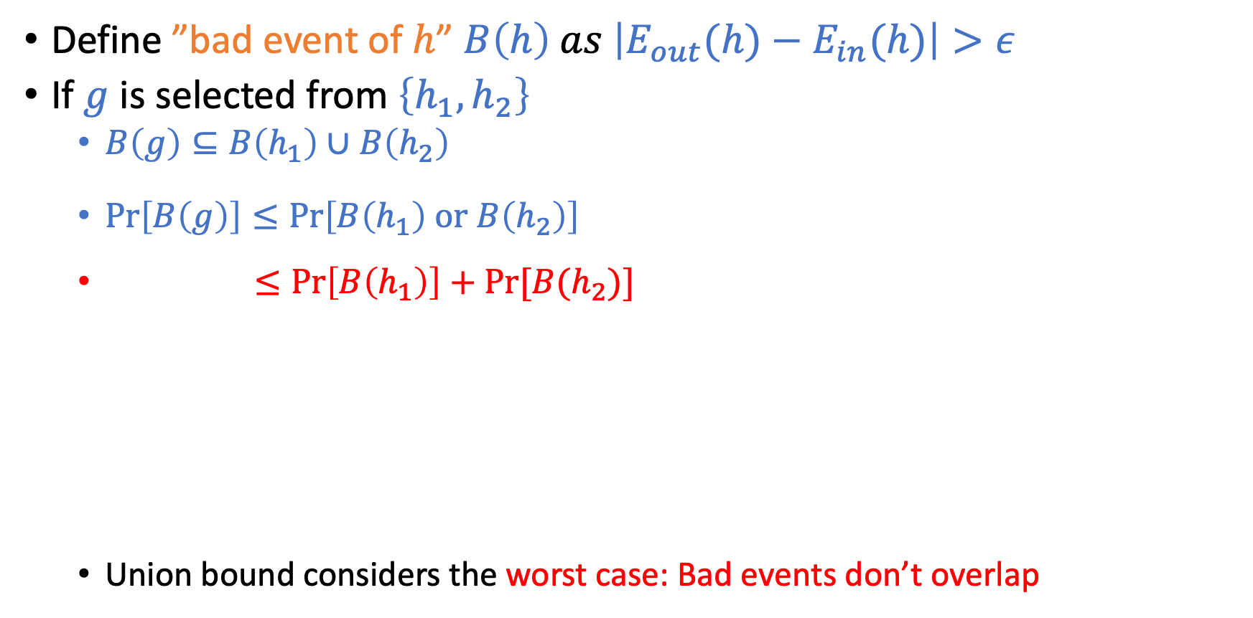
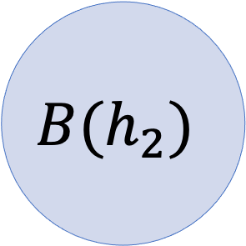
Key Intuitions in the Multi-Hypothesis Analysis
Define ”bad event of $h$” $B\left(h\right) as \left|E_{out}(h)−E_{in}(h)\right|>ε$
If $g$ is selected from $\left\{h_{1},h_{2}\right\}$
$B\left(g\right)⊆B\left(h_{1}\right)∪B\left(h_{2}\right)$
$\operatorname{Pr}\left[B\left(g\right)\right]≤\operatorname{Pr}\left[B\left(h_{1}\right) \text{or} B\left(h_{2}\right)\right]$
$≤\operatorname{Pr}\left[B\left(h_{1}\right)\right]+Pr⁡[B(h_{2})]$
Union bound considers the worst case: Bad events don’t overlap
(Union Bound)
$$B(h_{1})$$
$$B(h_{2})$$

Slide 24
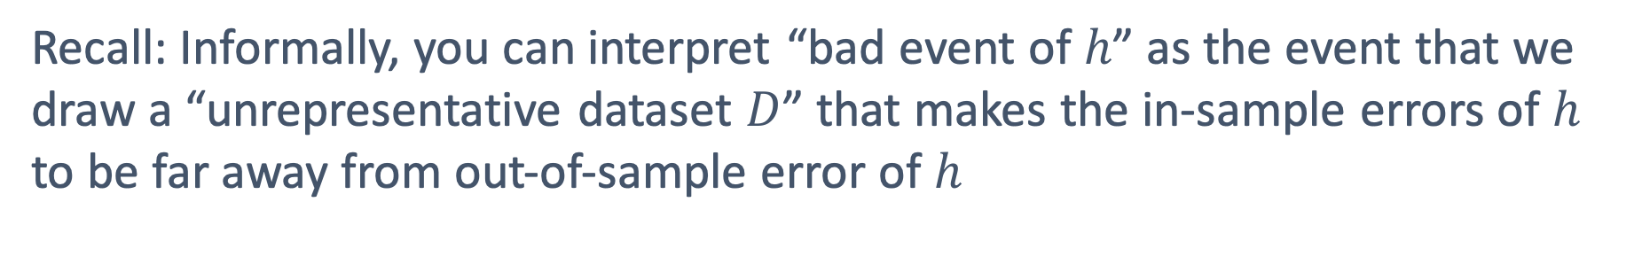
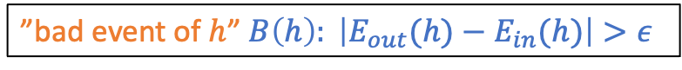
Do Bad Events Overlap?
Oftentimes, they overlap a lot!
The two linear separators on the left make
the same predictions for most points.
If it’s a bad event for one, it’s likely to be
a bad event for the other.
”bad event of $h$” $B\left(h\right): \left|E_{out}(h)−E_{in}(h)\right|>ε$
Recall: Informally, you can interpret “bad event of $h$” as the event that we
draw a “unrepresentative dataset $D$” that makes the in-sample errors of $h$ to be far away from out-of-sample error of $h$

Slide 25





What Can We Do?
For this dataset,
any difference between A and B?
For this dataset, probably no difference.
They make the same predictions for every data point in this dataset.

Slide 26
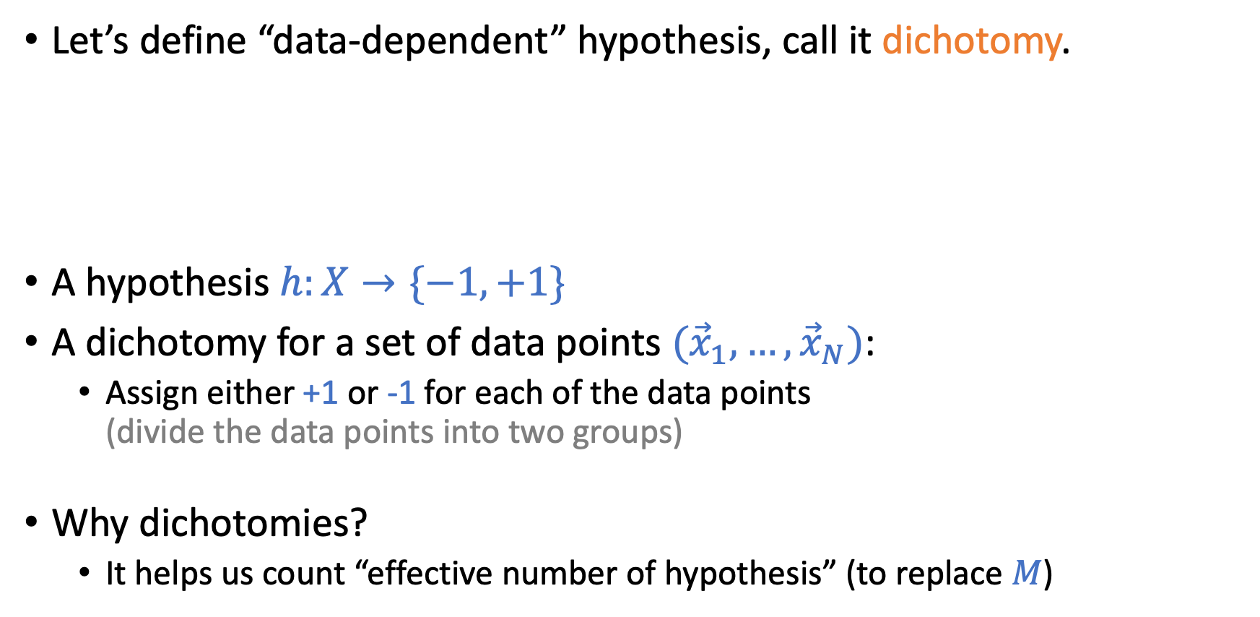
What Can We Do?
Let’s define “data-dependent” hypothesis, call it dichotomy.
A hypothesis $h:X→\{−1,+1\}$
A dichotomy for a set of data points $({\vec{x}}_{1},…,{\vec{x}}_{N})$:
Assign either +1 or -1 for each of the data points (divide the data points into two groups)
Why dichotomies?
It helps us count “effective number of hypothesis” (to replace $M$)

Slide 27
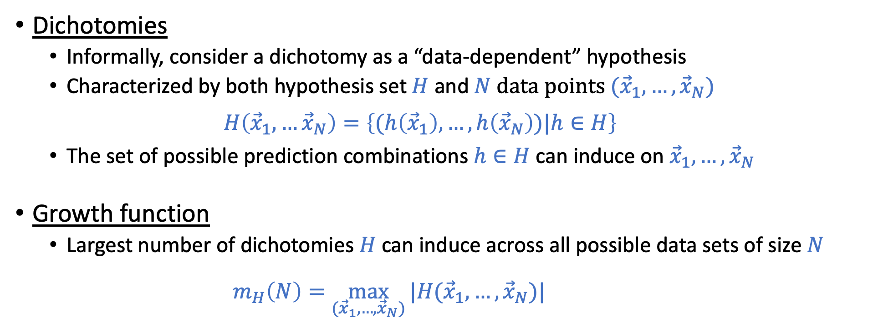
More Formal Definitions
Dichotomies
Informally, consider a dichotomy as a “data-dependent” hypothesis
Characterized by both hypothesis set $H$ and $N$ data points $({\vec{x}}_{1},…,{\vec{x}}_{N})$ $H\left({\vec{x}}_{1},…{\vec{x}}_{N}\right)=\left\{(h\left({\vec{x}}_{1}\right),…,h\left({\vec{x}}_{N}\right))|h∈H\right\}$
The set of possible prediction combinations $h∈H$ can induce on${\vec{x}}_{1},…,{\vec{x}}_{N}$
Growth function
Largest number of dichotomies $H$can induce across all possible data sets of size $N$
$m_{H}\left(N\right)=\max_{({\vec{x}}_{1},…,{\vec{x}}_{N})}{|H({\vec{x}}_{1},…,{\vec{x}}_{N})|}$

Slide 28
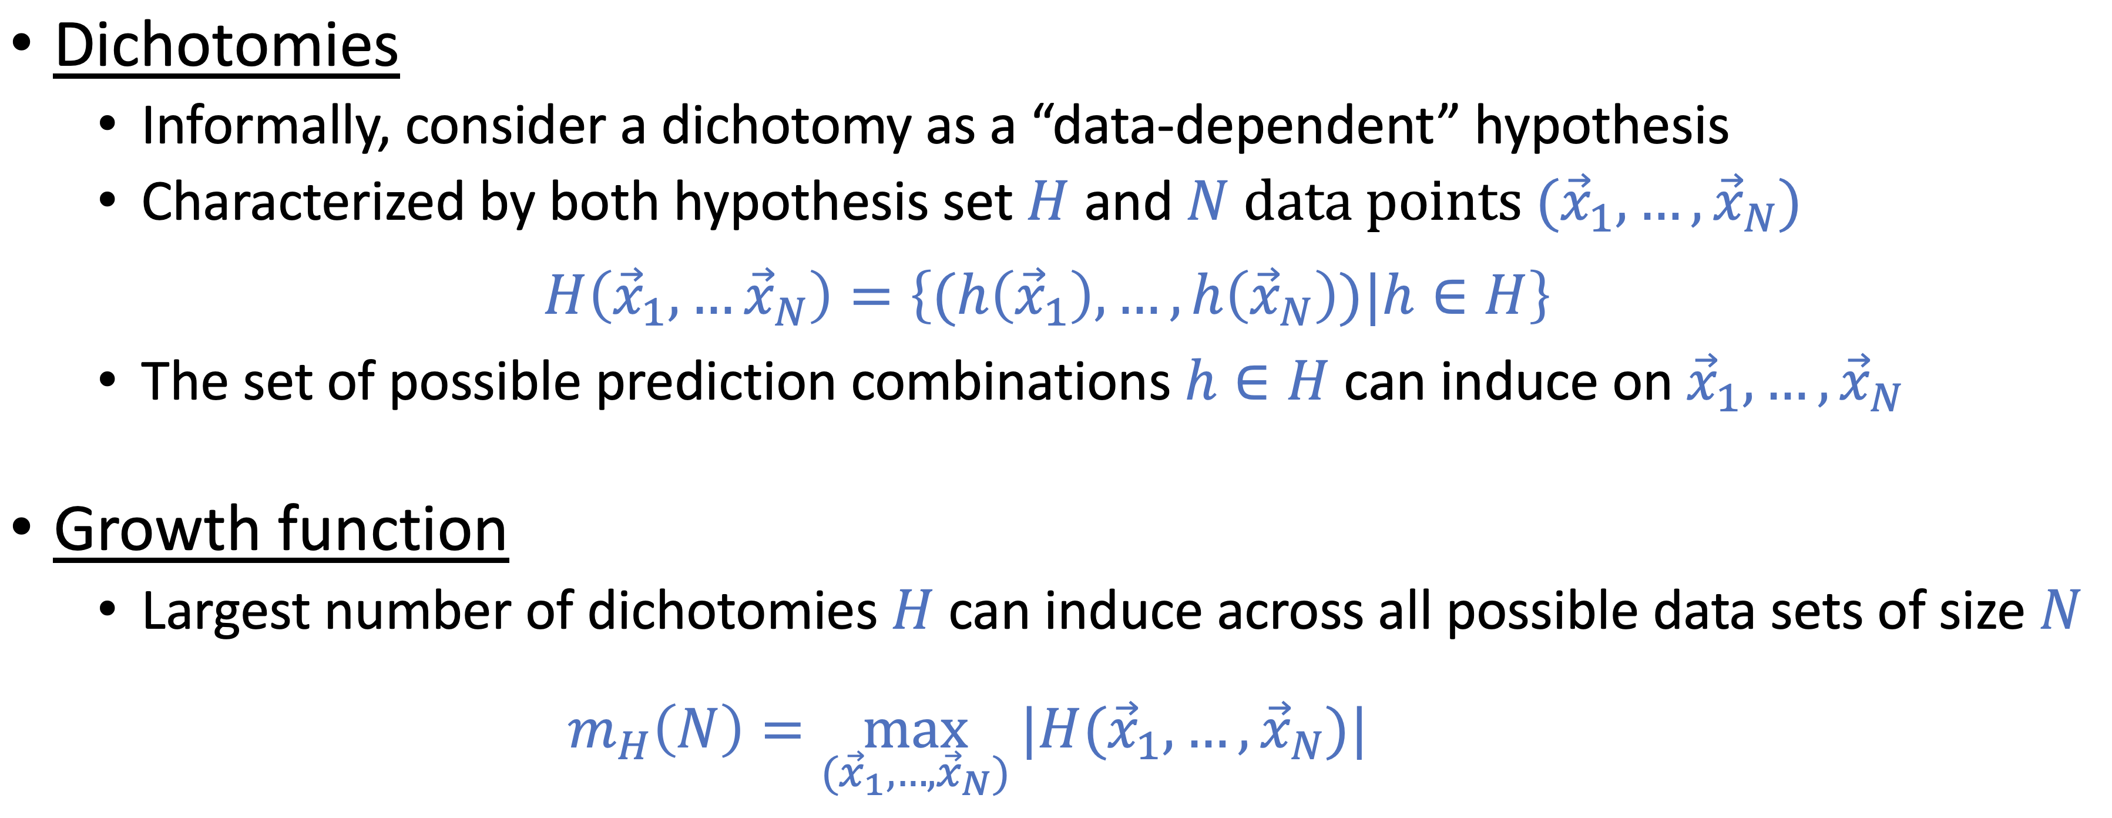
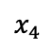
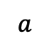
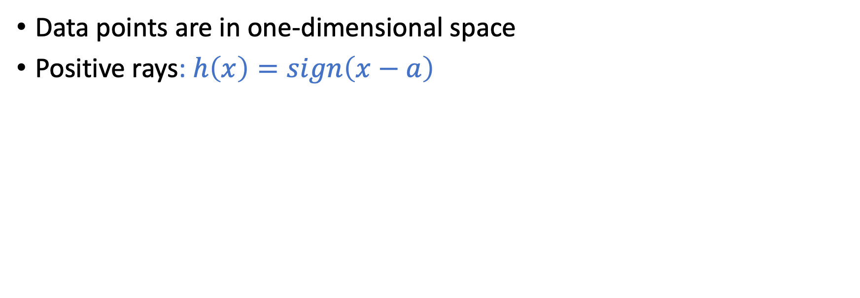
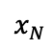
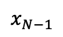

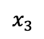
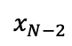
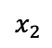

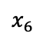
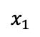
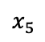

Example: $H=$Positive Rays
Data points are in one-dimensional space
Positive rays: $h\left(x\right)=sign\left(x−a\right)$
Predict -1
Predict +1
…
$$x_{1}$$
$$x_{2}$$
$$x_{3}$$
$$x_{4}$$
$$x_{5}$$
$$x_{6}$$
$$x_{N−2}$$
$$x_{N−1}$$
$$x_{N}$$
$$a$$
What is $H({\vec{x}}_{1},…,{\vec{x}}_{N})?$
What is $m_{H}\left(N\right)?$

Slide 29
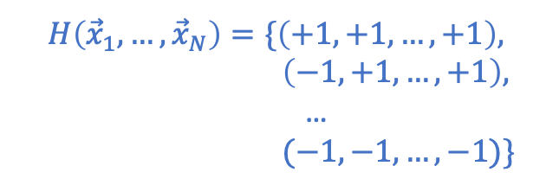
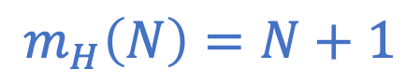
Example: $H=$Positive Rays
Data points are in one-dimensional space
Positive rays: $h\left(x\right)=sign\left(x−a\right)$
Predict -1
Predict +1
…
$$x_{1}$$
$$x_{2}$$
$$x_{3}$$
$$x_{4}$$
$$x_{5}$$
$$x_{6}$$
$$x_{N−2}$$
$$x_{N−1}$$
$$x_{N}$$
$$a$$
What is $H({\vec{x}}_{1},…,{\vec{x}}_{N})?$
What is $m_{H}\left(N\right)?$
$$m_{H}\left(N\right)=N+1$$
$$H\left({\vec{x}}_{1},…,{\vec{x}}_{N}\right)=\{\left(+1,+1,…,+1\right),$$ $\left(−1,+1,…,+1\right),$
…
$$(−1,−1,…,−1)\}$$

Slide 30
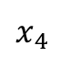
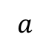
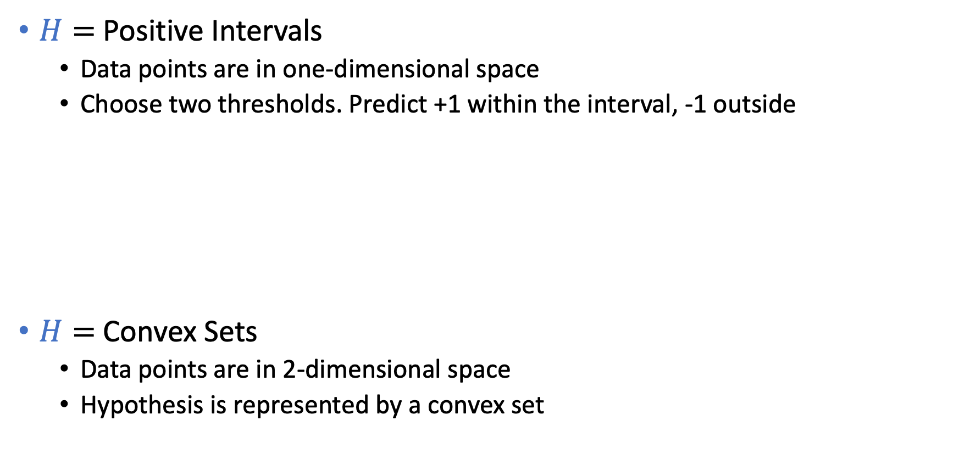
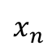
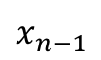

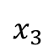
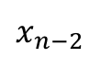
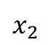
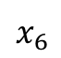
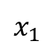
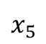
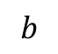
What is $m_{H}\left(N\right)$?
$H=$Positive Intervals
Data points are in one-dimensional space
Choose two thresholds. Predict +1 within the interval, -1 outside
$H=$Convex Sets
Data points are in 2-dimensional space
Hypothesis is represented by a convex set
Predict -1
Predict +1
Predict -1
…
$$x_{1}$$
$$x_{2}$$
$$x_{3}$$
$$x_{4}$$
$$x_{5}$$
$$x_{6}$$
$$x_{n−2}$$
$$x_{n−1}$$
$$x_{n}$$
$$a$$
$$b$$
Predict +1
Predict -1

Slide 31
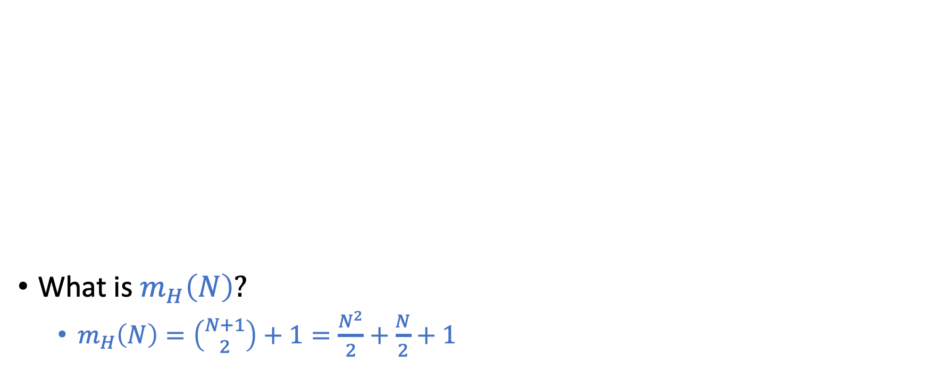
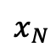



Example: $H=$Positive Intervals
What is $m_{H}\left(N\right)?$
$m_{H}\left(N\right)=\left({N+1 \atop 2}\right)+1=\frac{N^{2}}{2}+\frac{N}{2}+1$
Predict -1
Predict +1
Predict -1
…
$$x_{1}$$
$$x_{2}$$
$$x_{3}$$
$$x_{4}$$
$$x_{5}$$
$$x_{6}$$
$$x_{N−2}$$
$$x_{N−1}$$
$$x_{N}$$
$$a$$
$$b$$

Slide 32



Example: $H=$Convex Sets
Predict +1
Predict -1
What is $m_{H}\left(N\right)?$
$m_{H}\left(N\right)=2^{N}$
Note:
$m_{H}\left(N\right)≤2^{N}$ for all $H$ and all $N$
(There are only $2^{N}$ possible label combinations for $N points$)

Slide 33

Why Growth Function?
Growth function $m_{H}\left(N\right)$
Largest number of “effective” hypothesis $H$ can induce on $N$ data points
A more precise “complexity” measure for $H$
Goal: Replace $M$ in finite-hypothesis analysis with $m_{H}\left(N\right)$
With prob $1−δ, E_{out}\left(g\right)≤E_{in}\left(g\right)+\sqrt{\frac{1}{2N}ln\frac{2M}{δ}}$
Theorem: VC Inequality (1971)
With prob $1−δ$
$E_{out}\left(g\right)≤E_{in}\left(g\right)+\sqrt{\frac{8}{N}ln\frac{4m_{H}(2N)}{δ}}$

Slide 34


Growth Functions for Other $H$
$H=$2-D Perceptron
What is $m_{H}\left(3\right)$
What is $m_{H}\left(4\right)$

Slide 35

Growth Functions for Other $H$
$H=$2-D Perceptron
What is $m_{H}\left(3\right)$
What is $m_{H}\left(4\right)$
Exactly calculating the growth function is generally hard!
Next lecture
Discuss how we can “bound” the growth function
Introduce the notion of VC dimension

Slide 36

Growth Functions for Other $H$
$H=$2-D Perceptron
What is $m_{H}\left(3\right)$
What is $m_{H}\left(4\right)$
Exactly calculating the growth function is generally hard!
Goal: “bound” the growth function using some proxy

Slide 37


Bounding Growth Function
More definitions….
Shatter:
$H$ shatters $({\vec{x}}_{1},…,{\vec{x}}_{N})$ if $\left|H\left({\vec{x}}_{1},…,{\vec{x}}_{N}\right)\right|=2^{N}$
$H$ can induce all label combinations for $({\vec{x}}_{1},…,{\vec{x}}_{N})$
Break point
$k$ is a break point for $H$ if no data set of size $k$ can be shattered by $H$
A peek at the key result (take this as a fact for now)
If there are no break points for $H$, $m_{H}\left(N\right)=2^{N}$
If $k$ is a break point for $H$, $m_{H}\left(N\right)$ is polynomial in $N.$ In particular, $m_{H}\left(N\right)=O(N^{k−1})$
A bit more accurately:
$m_{H}\left(N\right)≤\sum_{i=1}^{k−1}{\left({N \atop i}\right)}$, or
$m_{H}\left(N\right)≤N^{k−1}+1$

Slide 38


















Practice
What are the break points for
1. Positive Rays
2. Positive Intervals
3. Convex Sets
4. 2-D Perceptron
Predict -1
Predict +1
Predict -1
Predict +1
Predict -1
Predcit +1
$$x_{1}$$
$$x_{2}$$
$$x_{3}$$
$$x_{4}$$
$$x_{5}$$
$$x_{6}$$
…
$$x_{N−2}$$
$$x_{N−1}$$
$$x_{N}$$
…
Predict -1
$$x_{1}$$
$$x_{2}$$
$$x_{3}$$
$$x_{4}$$
$$x_{5}$$
$$x_{6}$$
$$x_{N−2}$$
$$x_{N−1}$$
$$x_{N}$$
$$a$$
$$a$$
$$b$$

Slide 39






Practice
$$m_{H}(N)$$
$$m_{H}(N)$$
 | N=1 | N=2 | N=3 | N=4 | N=5 | Break Points | VC Dimension
Positive Rays | 2 | 3 | 4 | 5 | 6 | $$k=2,3,4,…$$ | 1
Positive Intervals | 2 | 4 | 7 | 11 | 16 | $$k=3,4,5,…$$ | 2
Convex Sets | 2 | 4 | 8 | 16 | 32 | None | $$∞$$
2D Perceptron | 2 | 4 | 8 | 14 | ? | $$k=4,5,6,…$$ | 3
$$N+1$$
$$\frac{N^{2}}{2}+\frac{N}{2}+1$$
$$2^{N}$$

Slide 40

Practice
$$m_{H}(N)$$
$$m_{H}(N)$$
 | N=1 | N=2 | N=3 | N=4 | N=5 | Break Points | VC Dimension
Positive Rays | 2 | 3 | 4 | 5 | 6 | $$k=2,3,4,…$$ | 1
Positive Intervals |  |  |  |  |  |  | 2
Convex Sets |  |  |  |  |  |  | $$∞$$
2D Perceptron |  |  |  |  |  |  | 3
$$N+1$$
$$\frac{N^{2}}{2}+\frac{N}{2}+1$$
$$2^{N}$$

Slide 41


Practice
$$m_{H}(N)$$
$$m_{H}(N)$$
 | N=1 | N=2 | N=3 | N=4 | N=5 | Break Points | VC Dimension
Positive Rays | 2 | 3 | 4 | 5 | 6 | $$k=2,3,4,…$$ | 1
Positive Intervals | 2 | 4 | 7 | 11 | 16 | $$k=3,4,5,…$$ | 2
Convex Sets | 2 | 4 | 8 | 16 | 32 | None | $$∞$$
2D Perceptron | 2 | 4 | 8 | 14 | ? | $$k=4,5,6,…$$ | 3
$$N+1$$
$$\frac{N^{2}}{2}+\frac{N}{2}+1$$
$$2^{N}$$

Slide 42

Why Break Points?
Theorem statement (Again, take it as a fact for now)
If there is no break point for $H$, then $m_{H}\left(N\right)=2^{N}$ for all $N.$
If $k$ is a break point for $H$, i.e., if $m_{H}\left(k\right)<2^{k}$ for some value $k,$ then
$m_{H}\left(N\right)≤\sum_{i=0}^{k−1}{\left({N \atop i}\right)}$
Rephrase the above theorem
If there is no break point for $H$, then $m_{H}\left(N\right)=2^{N}$ for all $N.$
If $k$ is a break point for $H$, the following statements are true
$m_{H}\left(N\right)≤N^{k−1}+1$ [Can be proven using induction. See LFD Problem 2.5]
$m_{H}\left(N\right)=O(N^{k−1})$
$m_{H}\left(N\right)$ is polynomial in $N$
We can “bound” the growth function without knowing it exactly.
Find break point!

Slide 43

Why Break Points?
VC Generalization Bound
With prob $1−δ$
$E_{out}\left(g\right)≤E_{in}\left(g\right)+\sqrt{\frac{8}{N}ln\frac{4m_{H}(2N)}{δ}}$
In the following discussion, we treat $δ$ as a constant [i.e., with high probability, the following is true]
$E_{out}\left(g\right)≤E_{in}\left(g\right)+O\left(\sqrt{\frac{1}{N}\ln{m_{H}(N)}}\right)$
[For example, we can set $δ$ to be a small constant, say 0.01. Then every time we wrote the above inequality, we mean that it is true with probability at least 99%.]

Slide 44


Applying Break Points in VC Bound
If there are no break point ($m_{H}\left(N\right)=2^{N}$)
$E_{out}\left(g\right)≤E_{in}\left(g\right)+O(1)$ (This implies that we can’t infer $E_{out}$ from $E_{in}$ even when $N→∞$)
If $k$ is a break point for $H,$ i.e., $m_{H}\left(N\right)=O(N^{k−1})$
$E_{out}\left(g\right)≤E_{in}\left(g\right)+O\left(\sqrt{(k−1)\frac{ln⁡N}{N}}\right)$
VC Bound: $E_{out}\left(g\right)≤E_{in}\left(g\right)+O\left(\sqrt{\frac{1}{N}\ln{m_{H}(N)}}\right)$

Slide 45


Interpreting
$$\operatorname{Pr}\left[\left|E_{out}(g)−E_{in}(g)\right|>ϵ\right]≤2Me^{−2ϵ^{2}N}$$
Playing around with the math
Define $δ=Pr⁡[\left|E_{out}\left(g\right)−E_{in}\left(g\right)\right|>ε]$
We have $δ≤2Me^{−2ε^{2}N}$ => $ε≤\sqrt{\frac{1}{2N}\ln{\frac{2M}{δ}}}$
This means, with probability at least $1−δ$
$E_{out}\left(g\right)≤E_{in}\left(g\right)+ε≤E_{in}\left(g\right)+$ $\sqrt{\frac{1}{2N}\ln{\frac{2M}{δ}}}$

Slide 46

Interpreting
$$\operatorname{Pr}\left[\left|E_{out}(g)−E_{in}(g)\right|>ϵ\right]≤2Me^{−2ϵ^{2}N}$$
Define $δ=Pr⁡[\left|E_{out}\left(g\right)−E_{in}\left(g\right)\right|>ε]$
Statements:
With probability $δ$, $\left|E_{out}\left(g\right)−E_{in}\left(g\right)\right|>ε$
With probability $δ$, $E_{out}\left(g\right)−E_{in}\left(g\right)>ε$
$\text{With} \text{probability} 1−δ\text{, } E_{out}\left(g\right)−E_{in}\left(g\right)≤ε$
$\text{With} \text{probability} 1−δ\text{, } E_{out}\left(g\right)≤E_{in}\left(g\right)+ε$

Slide 47

Discussion/Interpretation on the learning bound
With probability at least $1−δ$ $E_{out}\left(g\right)≤E_{in}\left(g\right)+$ $\sqrt{\frac{1}{2N}\ln{\frac{2M}{δ}}}$ Consider $M$ as a proxy measure on the “complexity” of $H$
Our ultimate goal is to have a small $E_{out}\left(g\right)$
There is a tradeoff of choosing $M$ (what “learning model” to use)
Increase $M$ -> Smaller $E_{in}\left(g\right)$ (more hypothesis to “fit” the training data)
Increase $M$ -> Larger $ε$
It also depends on $N,$ the number of data points you have
A small number of data points => use simple models (e.g., linear models)
Complex models (e.g., deep learning) work when you have a lot of data

